Slide 1
Social Media Privacy Settings
How to make your profiles private on Instagram
Angelica Gonzalez, Lupe Heredia, Malia Xiong

Slide 2
Step 1: Once you are logged into instagram, on the toolbar, click the bottom right button

Slide 3
Step 2:Once you are on your profile, click “Edit your profile”

Slide 4
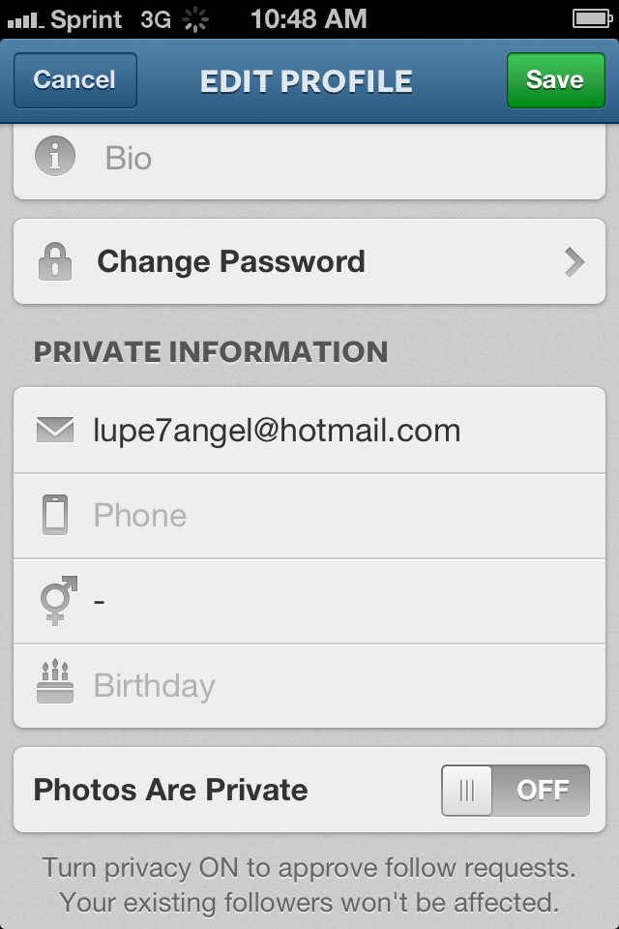
Step 3:: Scroll down to “private information”

Slide 5
Step 4:Look where it says “photos are private” and if it is OFF, click it and it should change to ON
DON’T FORGET TO SAVE YOUR SETTINGS!

